Slide 1
Lesson Five
Personal hygiene

Slide 2

Discuss
What should you do to have good personal hygiene when working with food?
Why is handwashing important for food workers?
Notes:
What should you do to have good personal hygiene when working with food?
Keeping yourself clean and tidy when working with food, including the hair and especially the hands.
Avoiding unhygienic habits.
Wearing clean protective outer clothing and keeping hair covered.
Washing your hands regularly throughout the work period. Always wash your hands when they are likely to be contaminated, for instance after going to the toilet or after handling raw meat or poultry.
Reporting symptoms of food borne illnesses or any illnesses with similar symptoms to your employer.
Why is handwashing important for food workers?
Handwashing is important to avoid contamination of food.

Slide 3
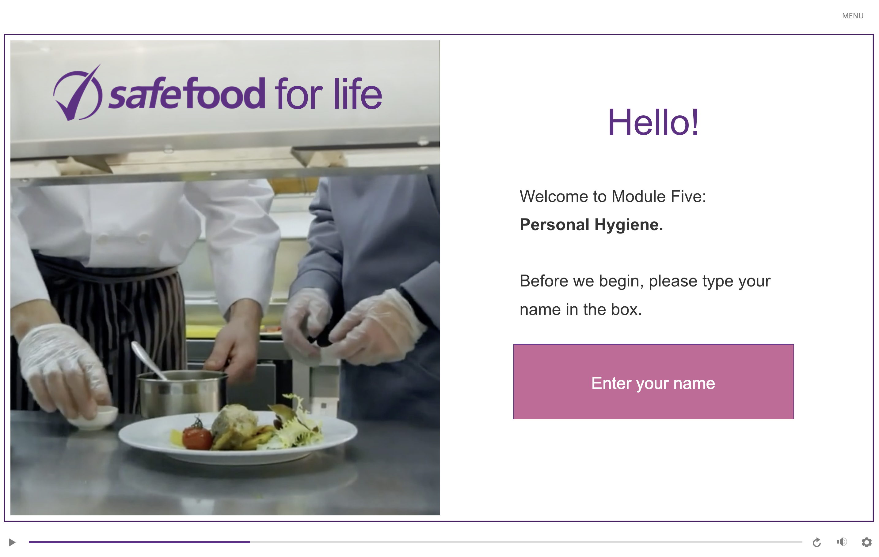
eLearning module

Slide 4
In class task
Research handwashing:
  Why do you need to wash your hands for at least 20 seconds?
  Why do you need to use soap?
  How does soap work?
  Does the water need to be warm?
  Why is it important to dry your hands?

Slide 5
Homework task
Create a handwashing diary that lists all of the times you washed your hands for a day. Include:
  When you washed your hands
  Reason for washing your hands (working with food, after sneezing, using the toilet or handling money and so on)
  Where you washed your hands
  How long you washed your hands for

